Slide 1

Openvolley eScoresheet
Quick guide

Slide 2
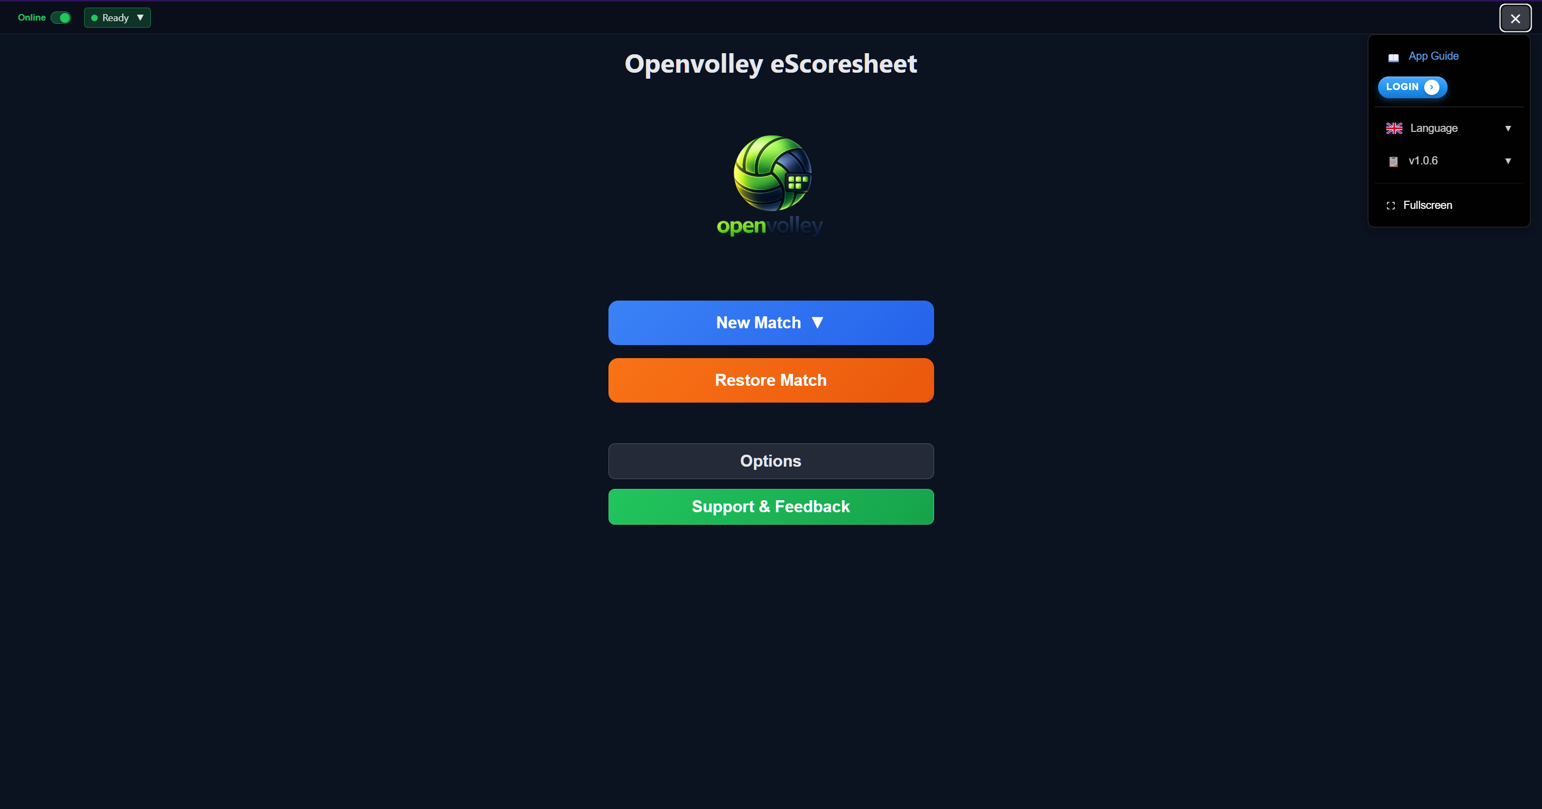
Home
App Guide
Scorer login (not mandatory)
Language
New match
Official (with backup)
Test (for playing around)
Restore match from Cloud or local backup

Slide 3
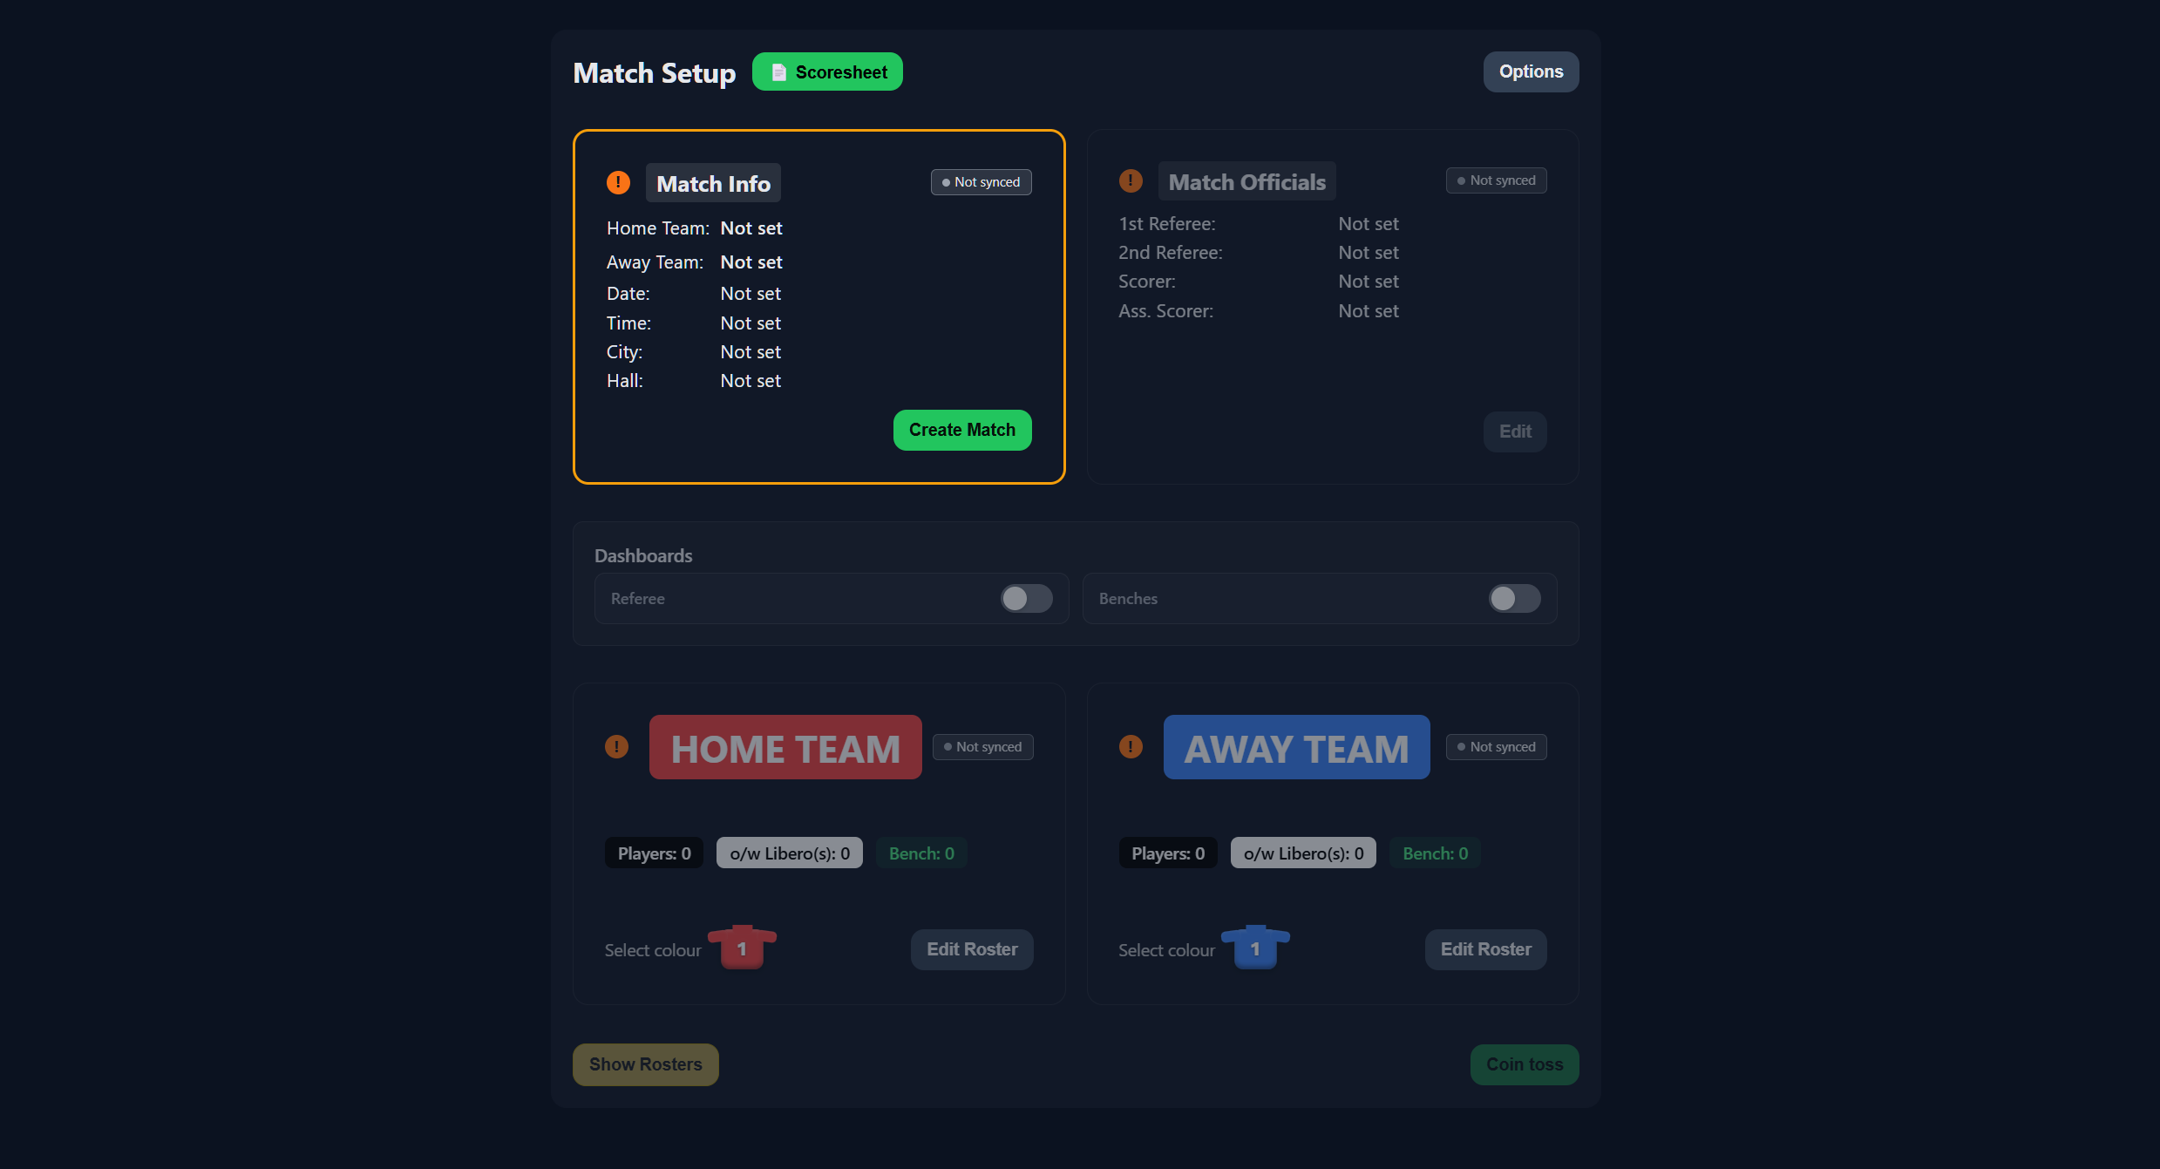
Match setup (Official)
Match info (most info can be loaded from SVRZ game calendar)
Officials input (1R and Scorer MANDATORY)
First, create match by filling match info, then the rest
Enable dashboards
Teams rosters

Slide 4
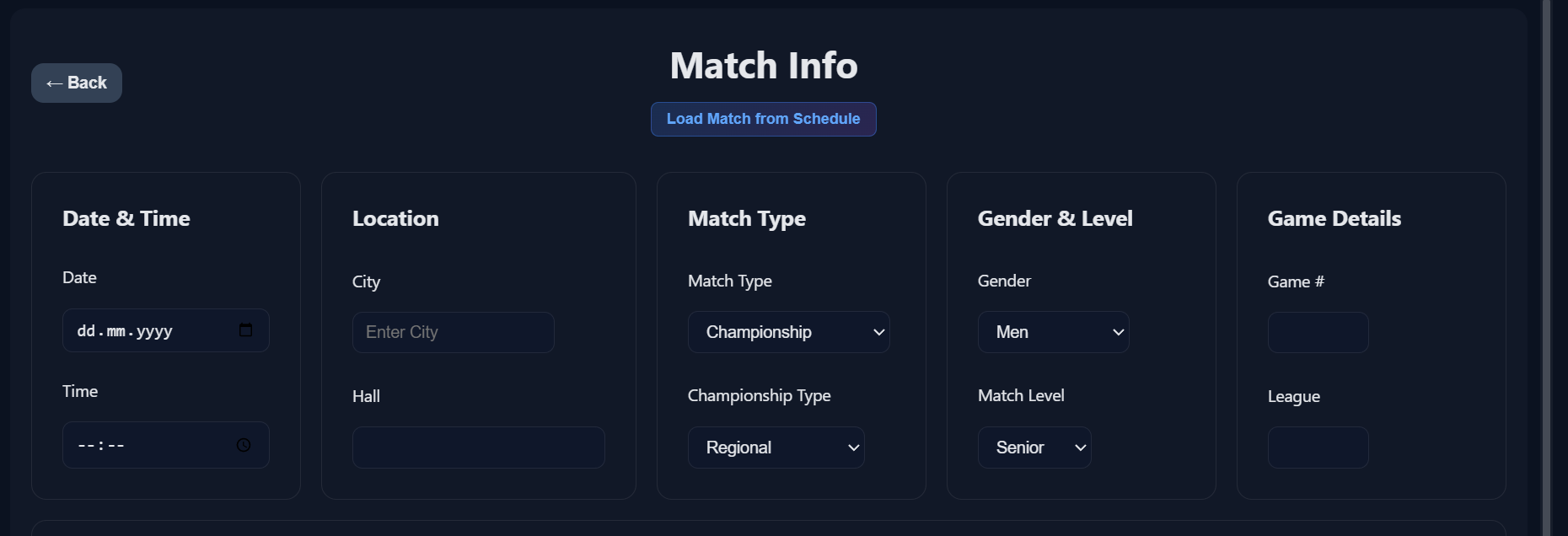
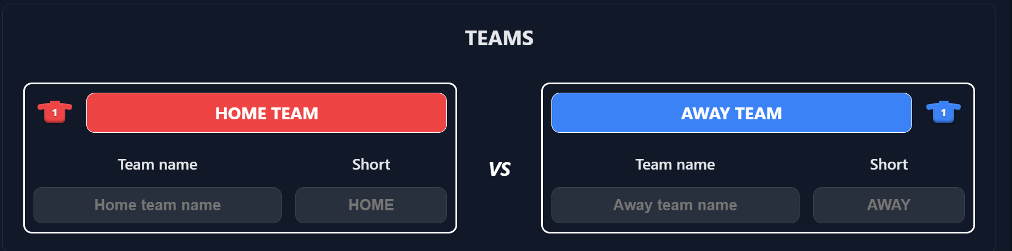
Loads from calendar, otherwise manual input
Match info
Team names (import or manual, colour selection, short name)

Slide 5
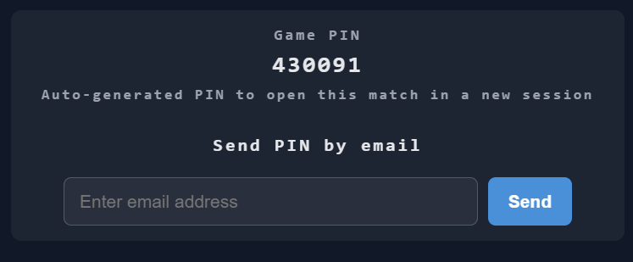
Match info
Team names (import or manual, colour selection, short name)
IMPORTANT: THE GAME PIN (together with the game number) allow you to recover the game in case of major issues. Either write it down or send it to your email for security purposes

Slide 6
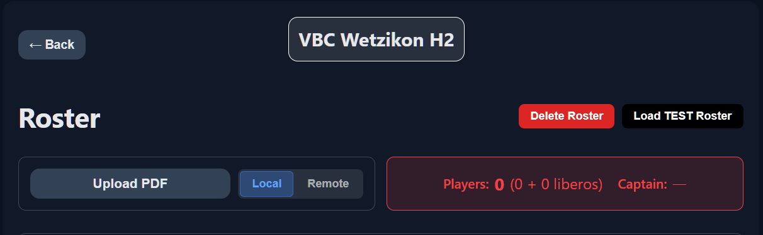
Team roster
Test roster if you need
Upload the einsatzliste via local pdf file (download from VM) or via the roster app (Remote)
To confirm the roster, at least 6 players (no liberos) and 1 captain

Slide 7
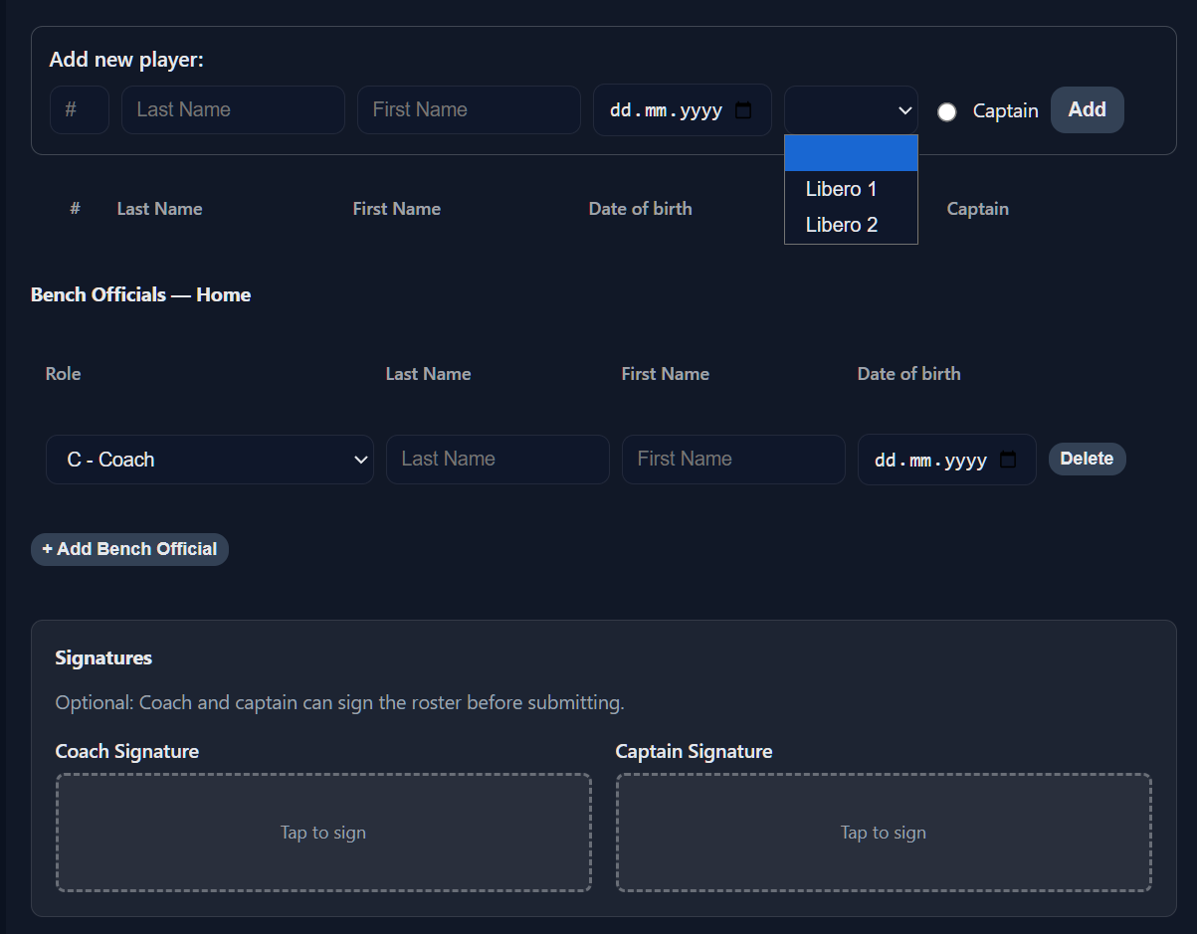
Team roster
Add new player, Libero, captain
Add new bench official (C, AC1, AC2, P, M)
Coach & Captain can sign already (or later at the coin toss)

Slide 8
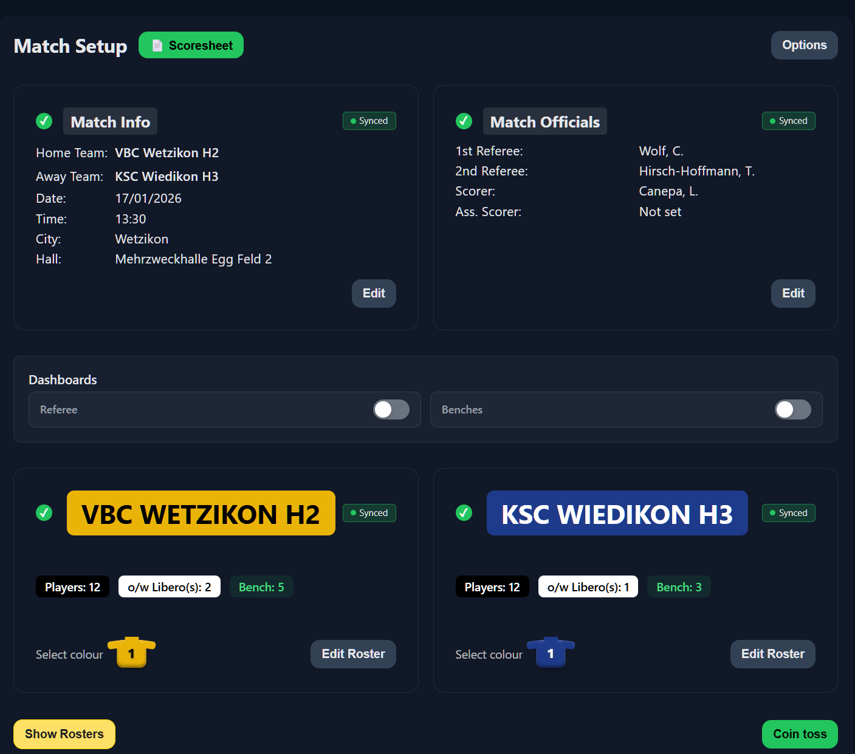
Match setup – Ready for coin toss

Slide 9
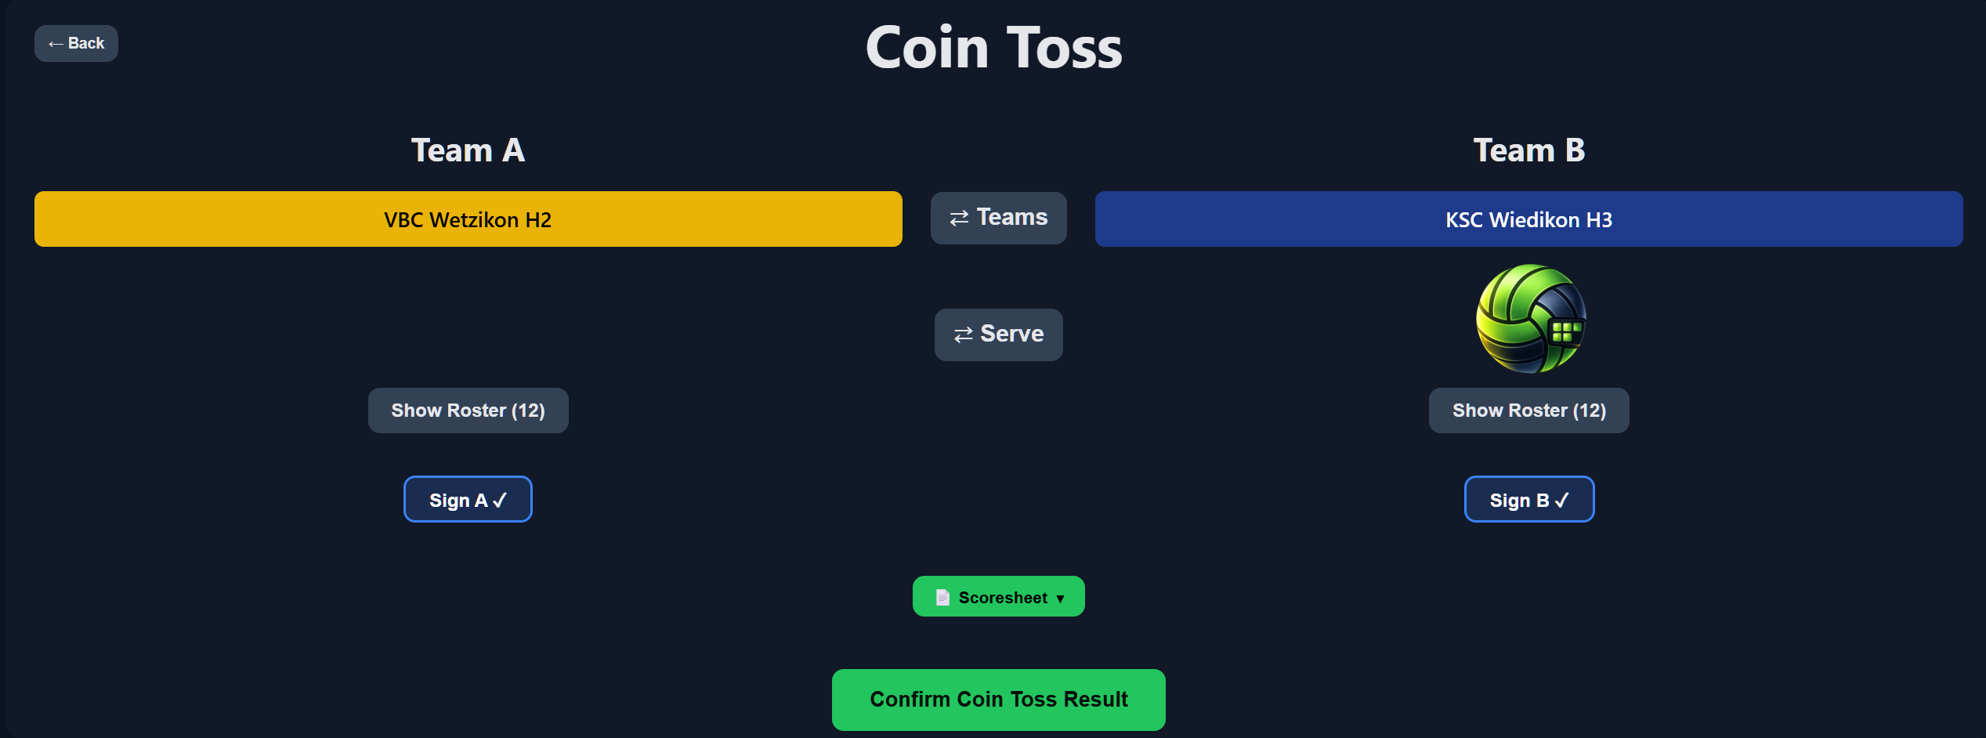
Coin toss
Self explanatory

Slide 10
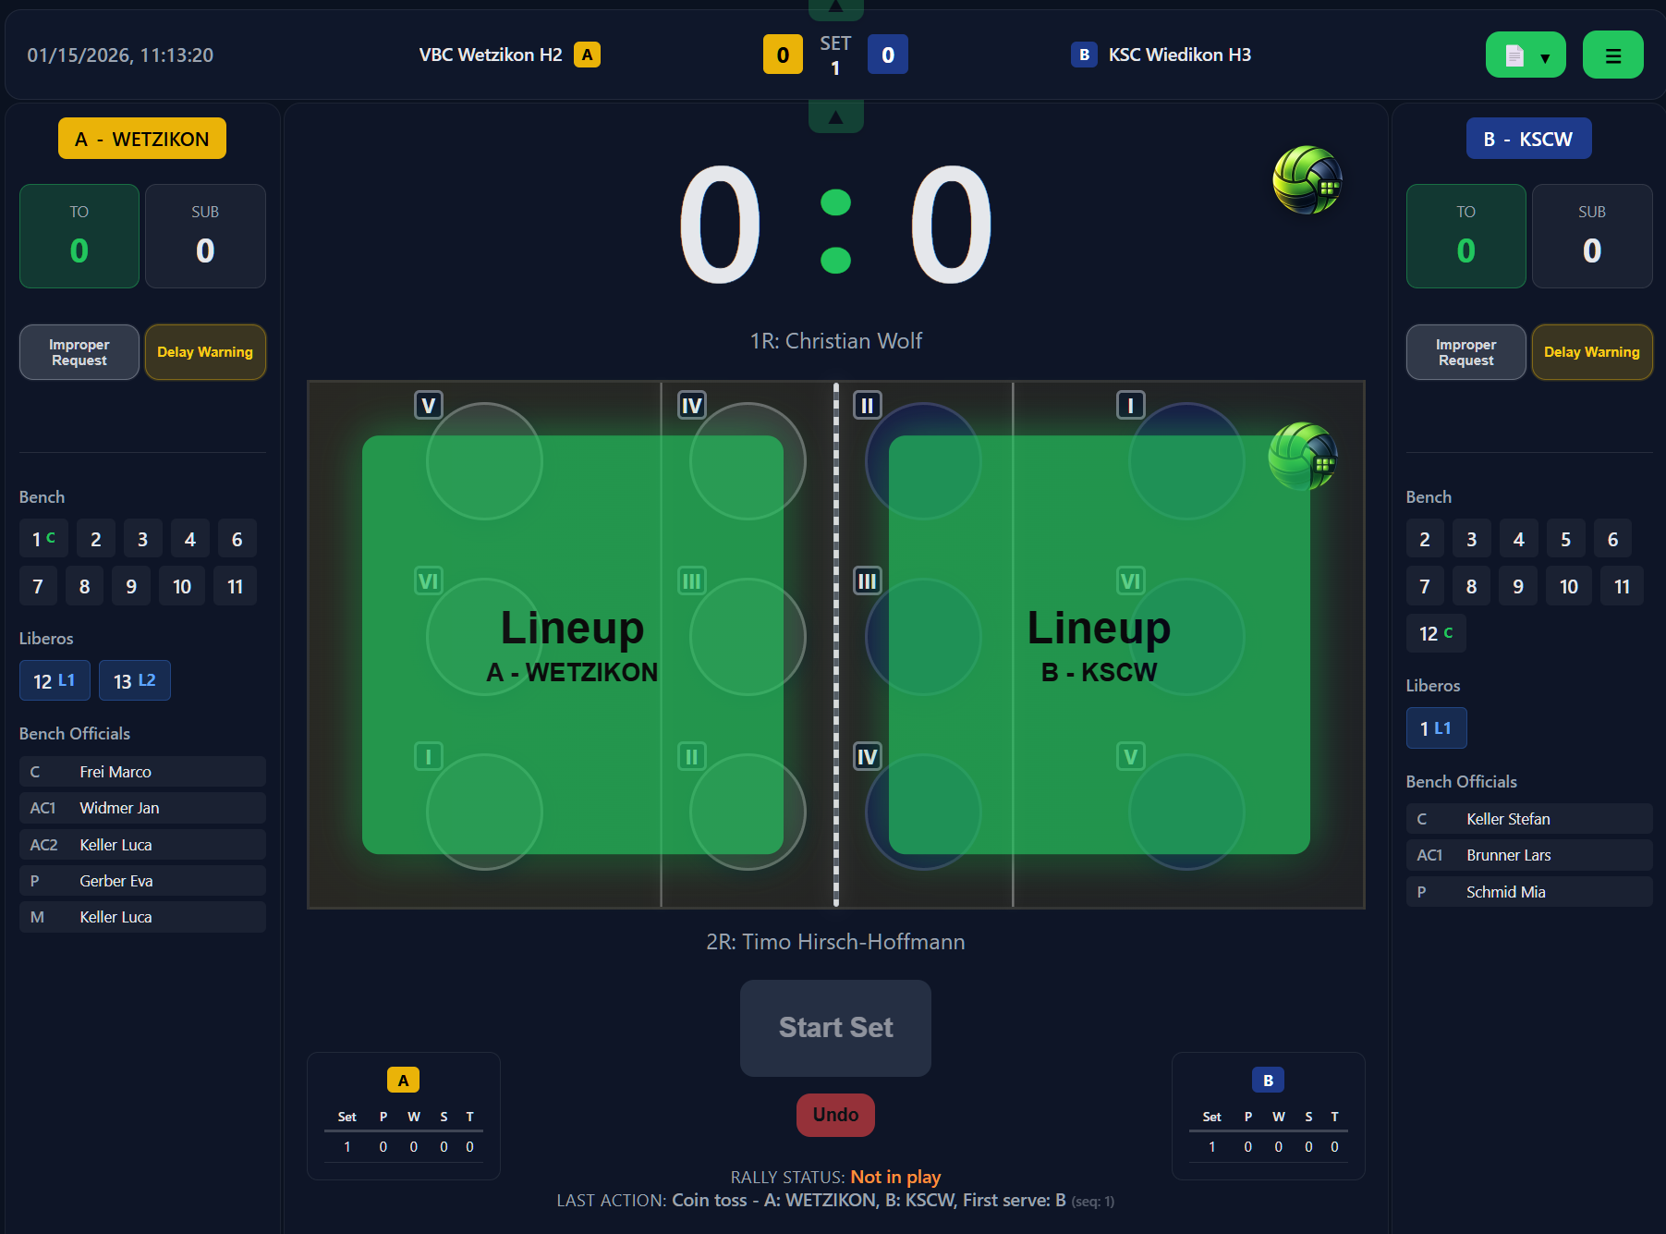
Main scoreboard
Team controls
Left
Score & serve
Team controls Right
Court
Rally Controls

Slide 11
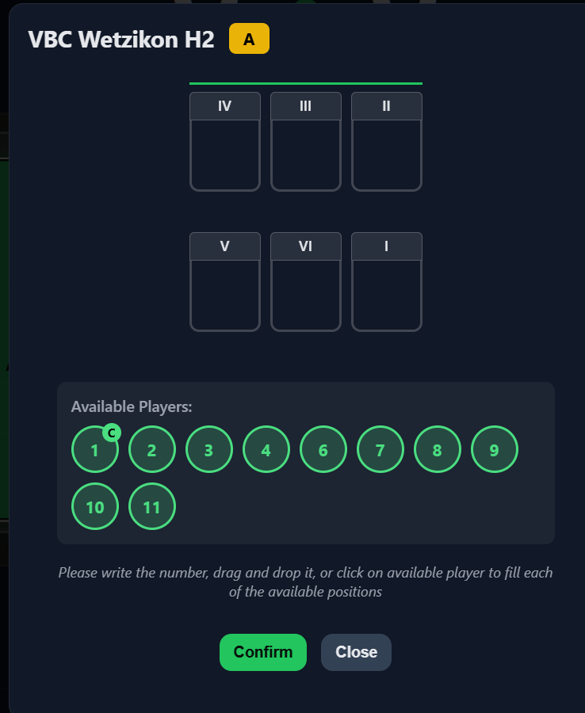
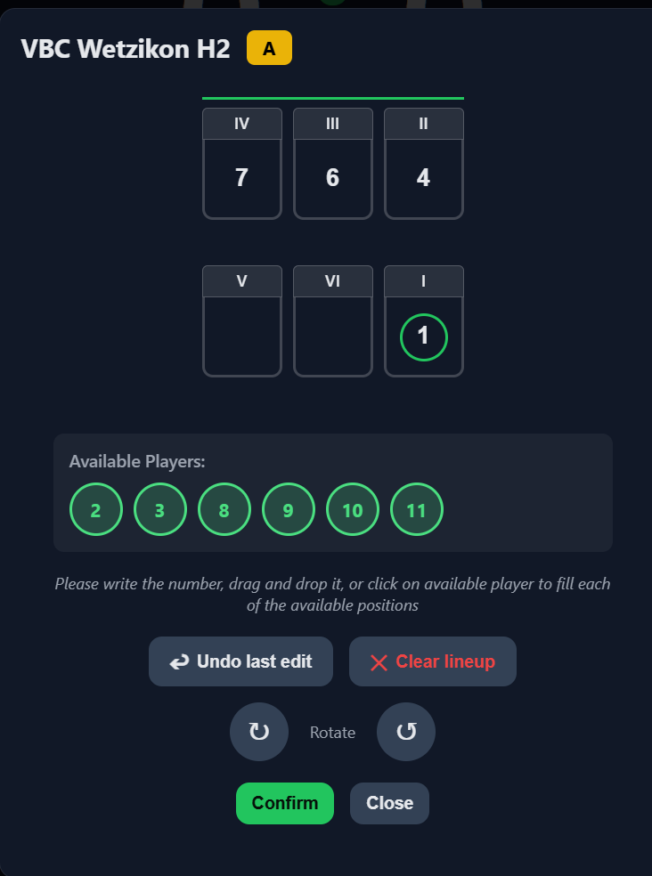
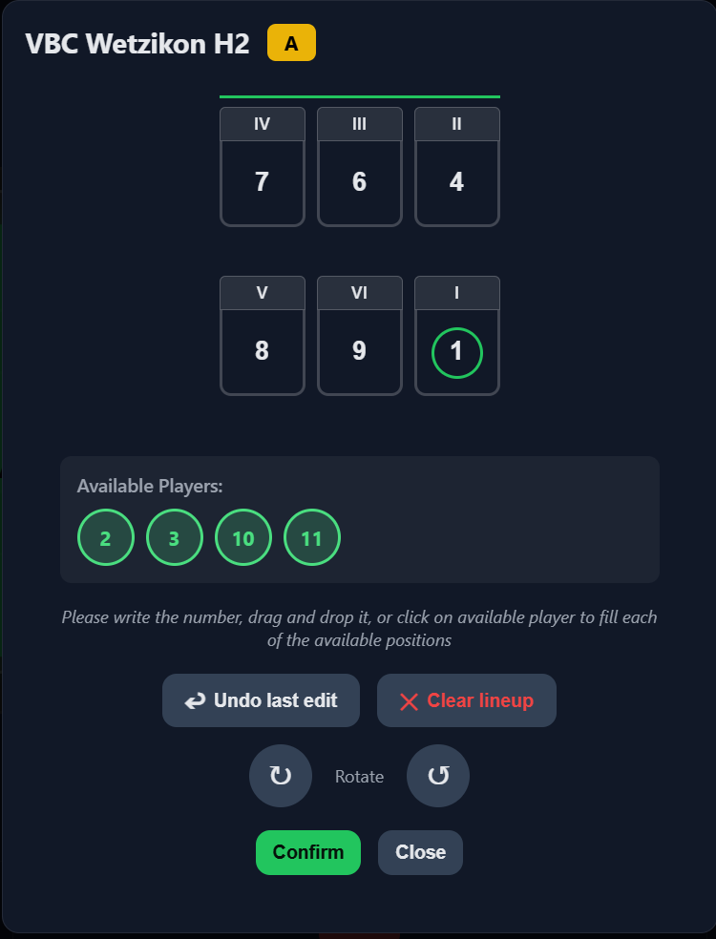
Lineup

Slide 12
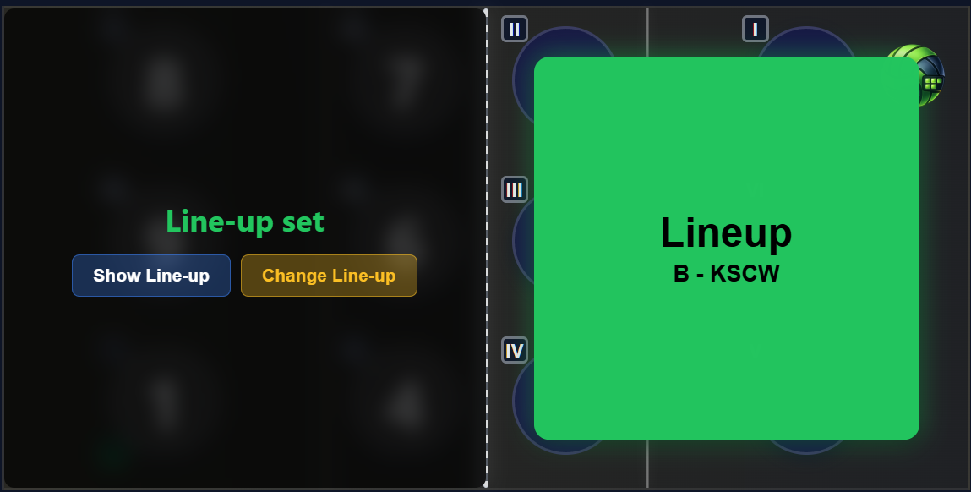
Lineup
Avoids the opponent team to see the other’s lineup until both are set. Click and keep pressed “Show line-up” to see it

Slide 13
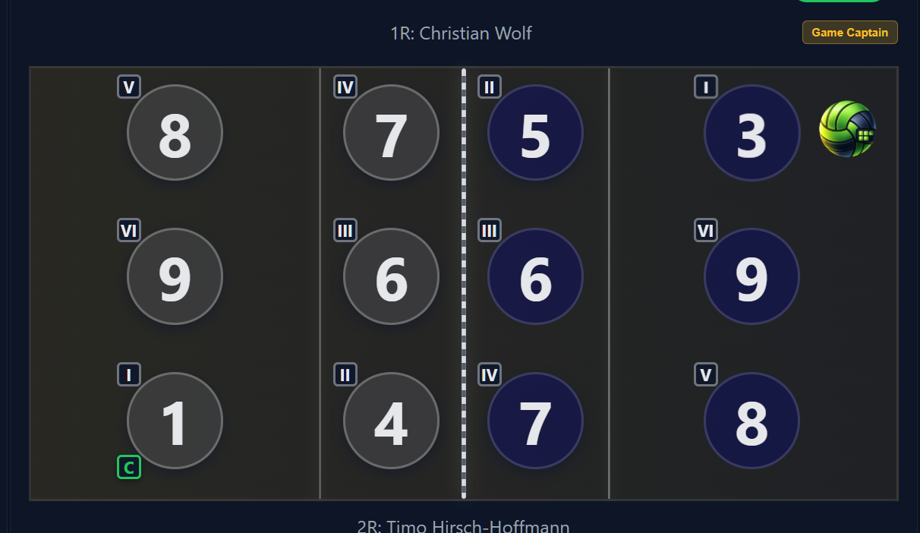
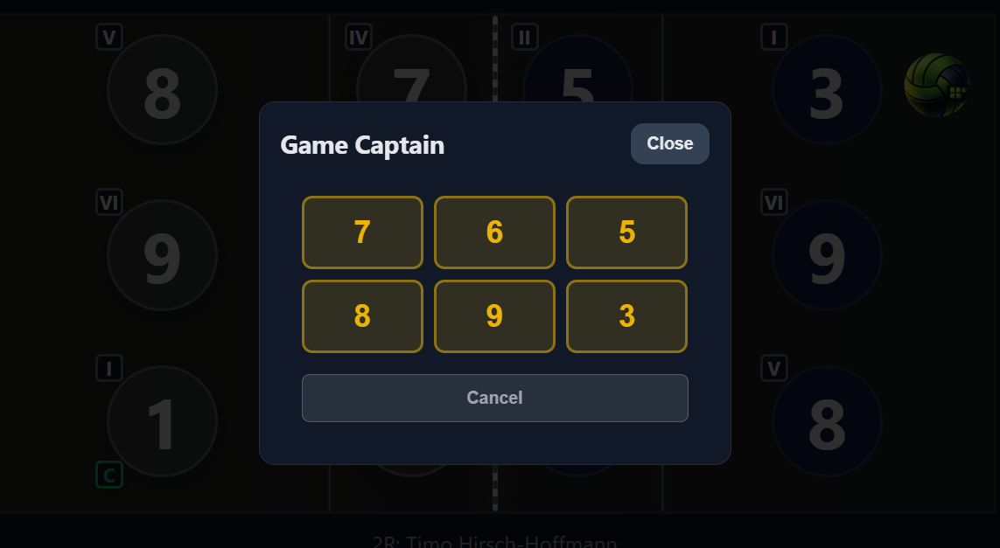
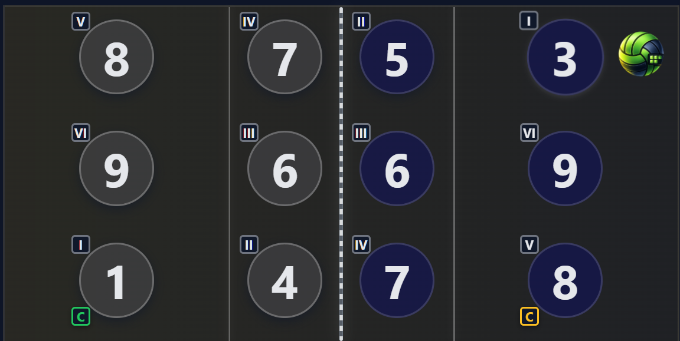
Lineup
Allows selecting a game captain. Voluntary unless “manage captain on court” is selected in options

Slide 14
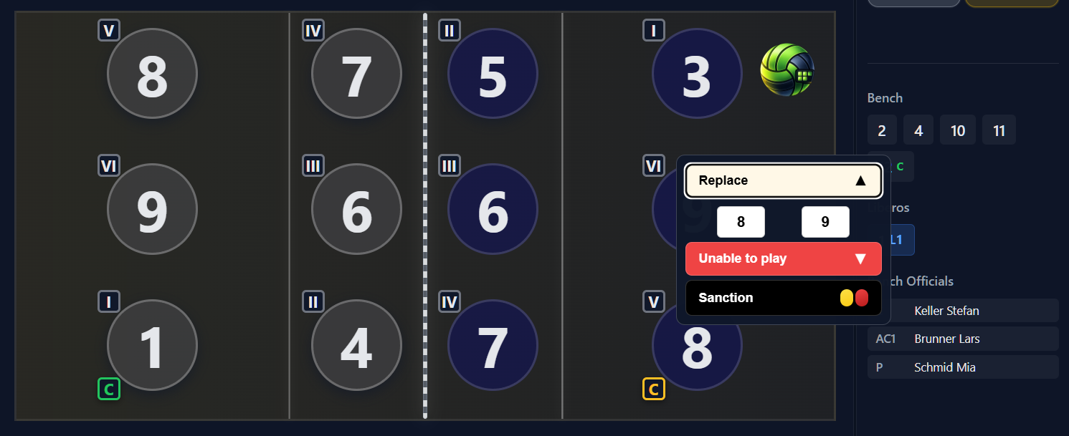
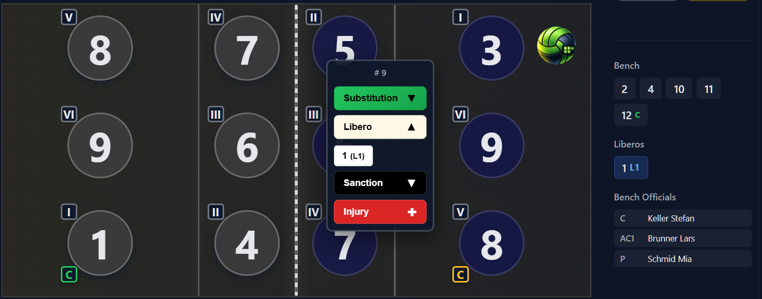
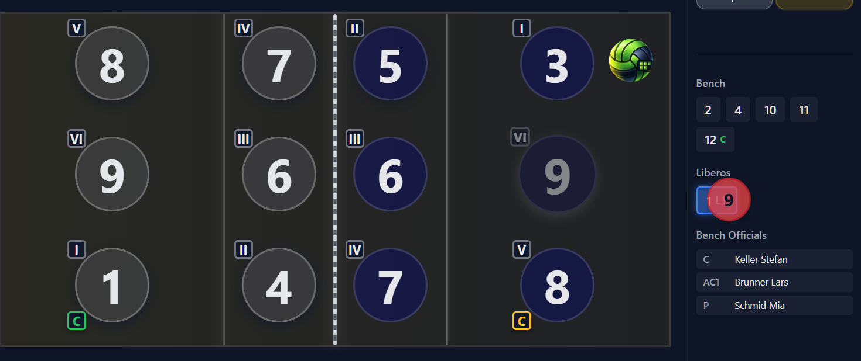
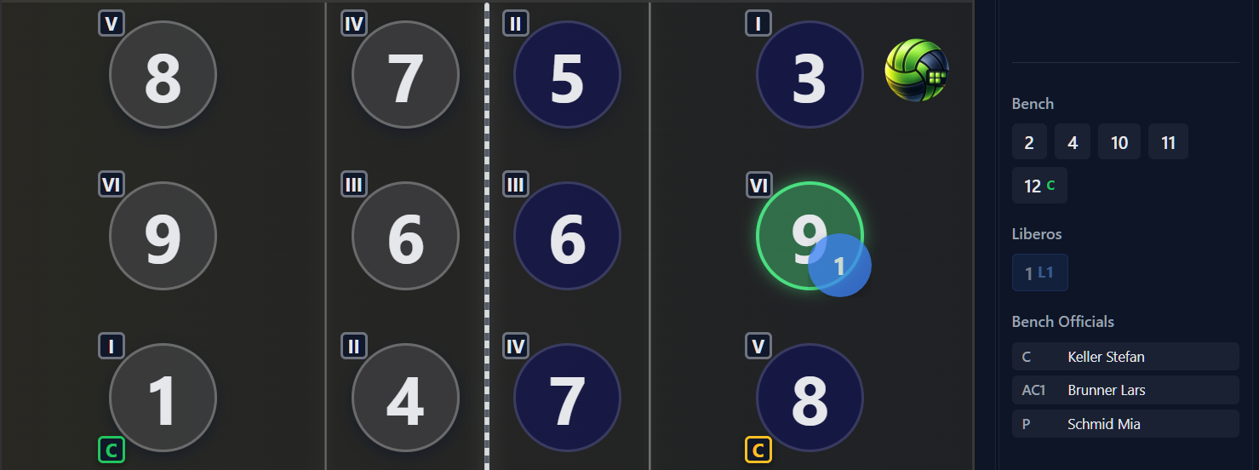
Libero in/out
Open the replace libero on either the player on the court or on the libero itself
Drag and drop the libero on the court player or vice-versa

Slide 15
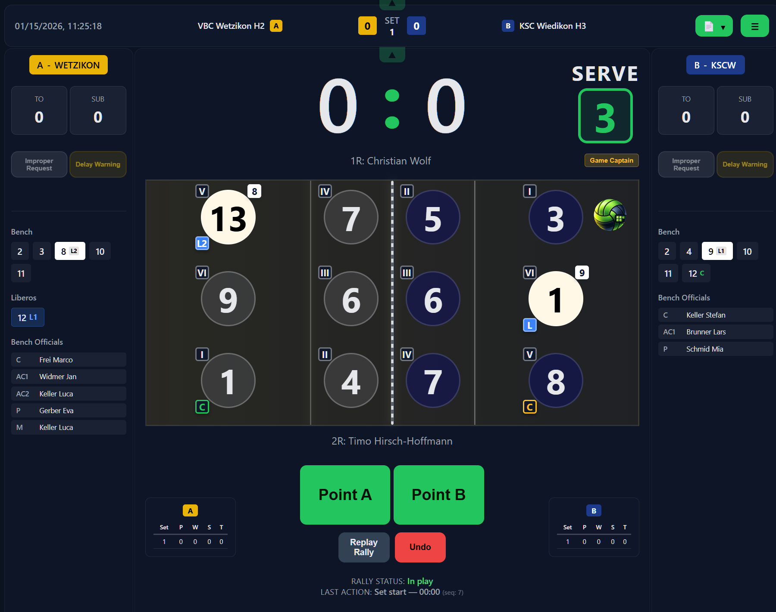
Match begins - Rally
Player at serve indicator for quicker check
Player at serve indicator for quicker check
Point left or right
Replay rally or undo

Slide 16
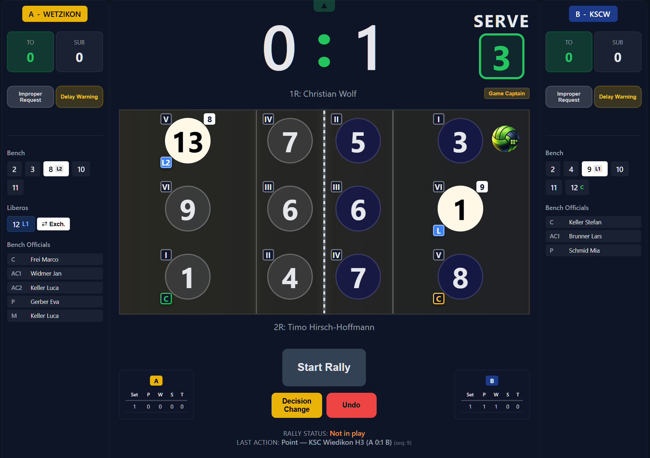
Between rallies
Click for TO
Click for delay sanctions
Click for substitutions and sanctions
Click any player for substitions, sanctions, injury
Click for sanctions

Slide 17
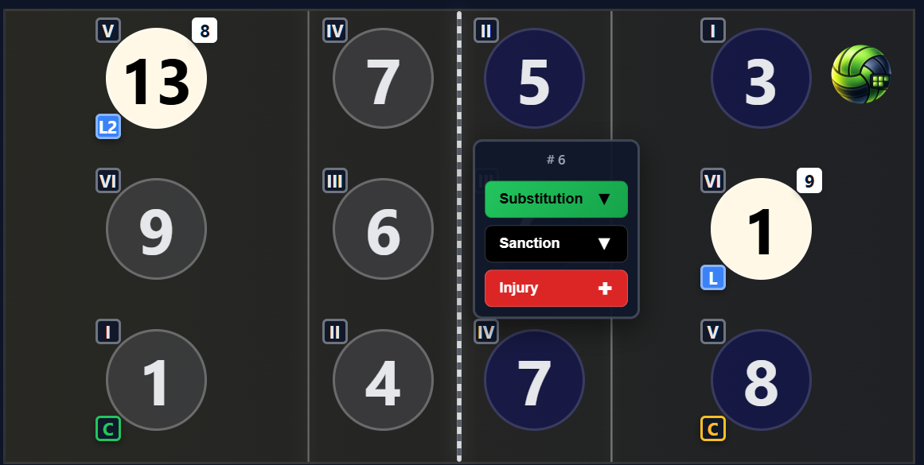
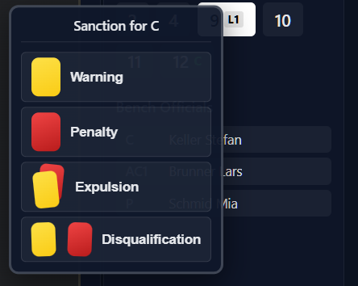
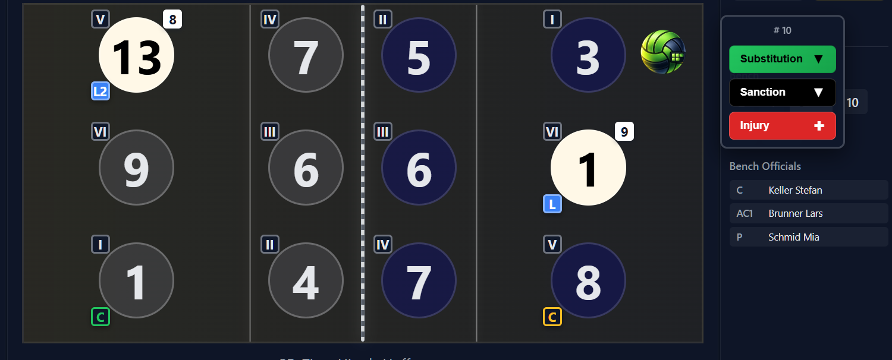
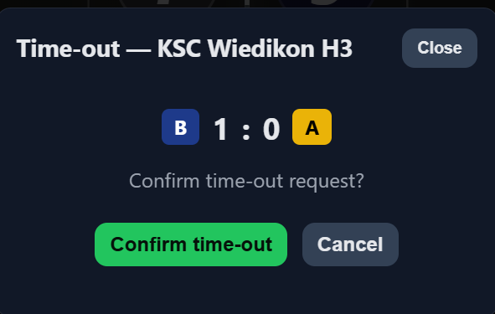
Between rallies

Slide 18
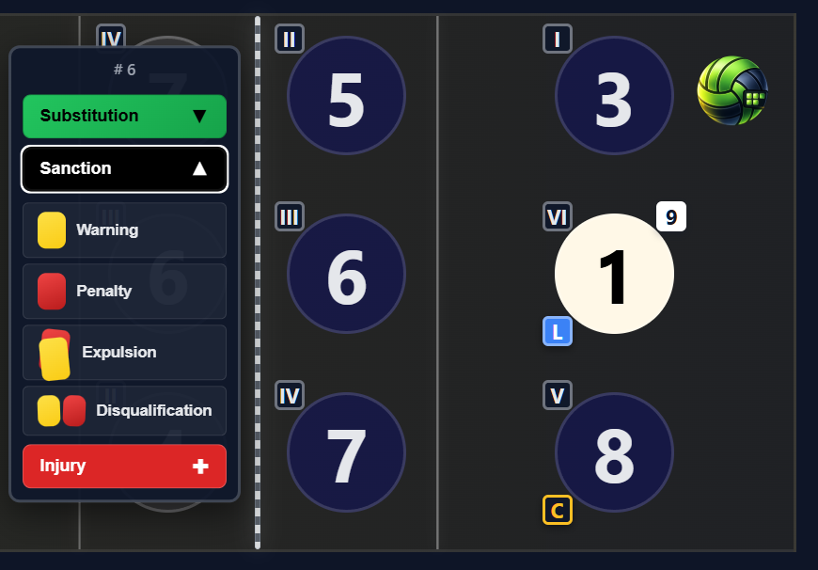
Sanctions
Click on sanction to impose a sanction. If Expulsion or Disqualification and the player is on the court, it automatically opens the substitution modal. Along with injury, if no regular substitution is possible, it opens the exceptional substitution modal

Slide 19
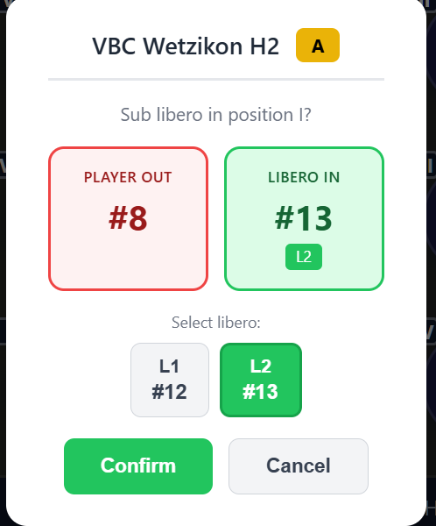
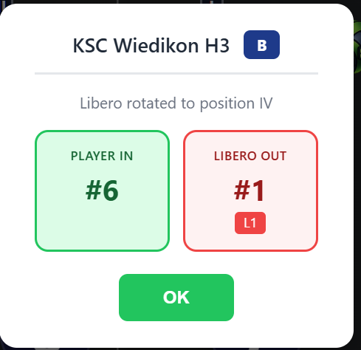
Libero modals
On by default, can be turned off in options

Slide 20
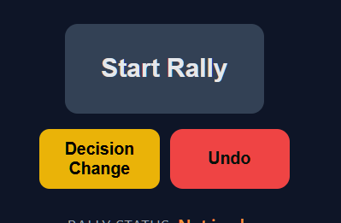
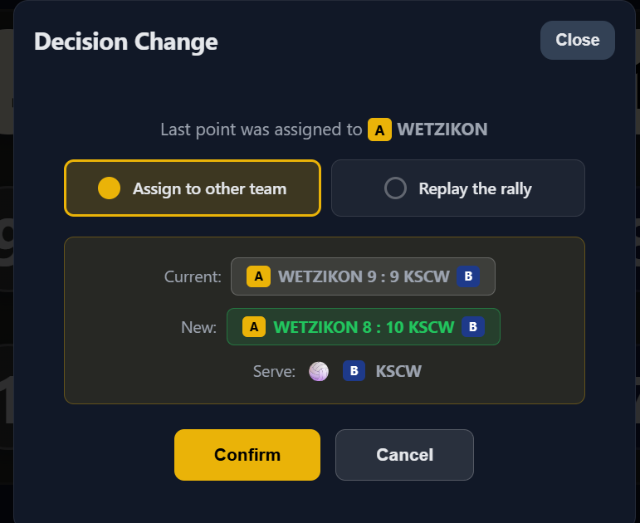
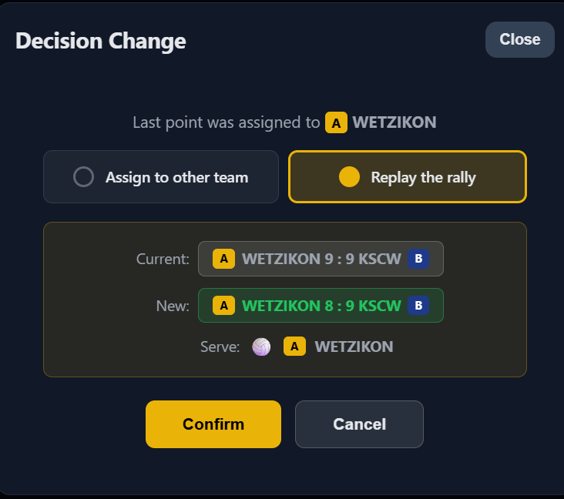
Decision change
After assigning a point, if the referee decides for a different outcome

Slide 21
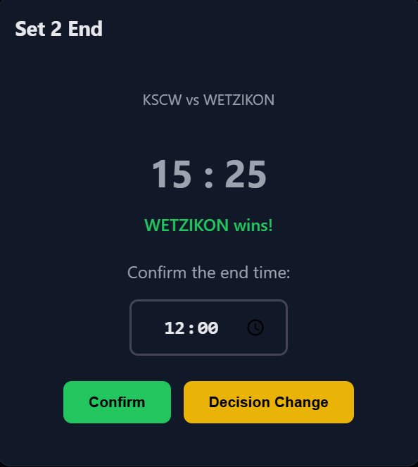
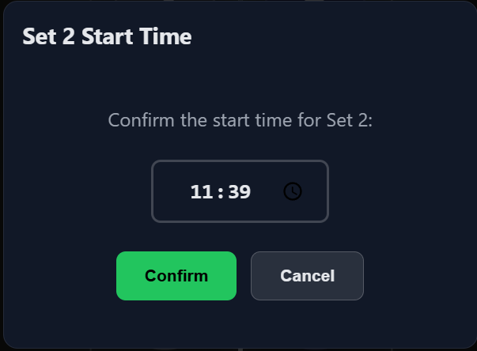
Set end/set start

Slide 22
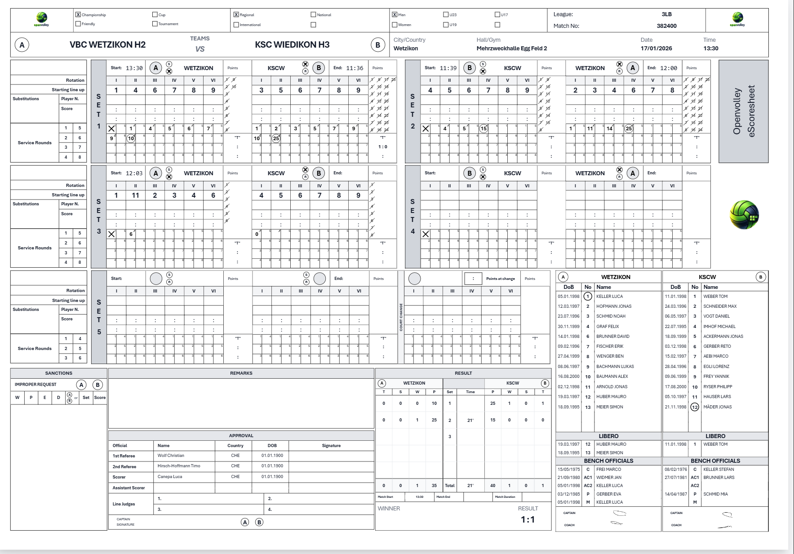
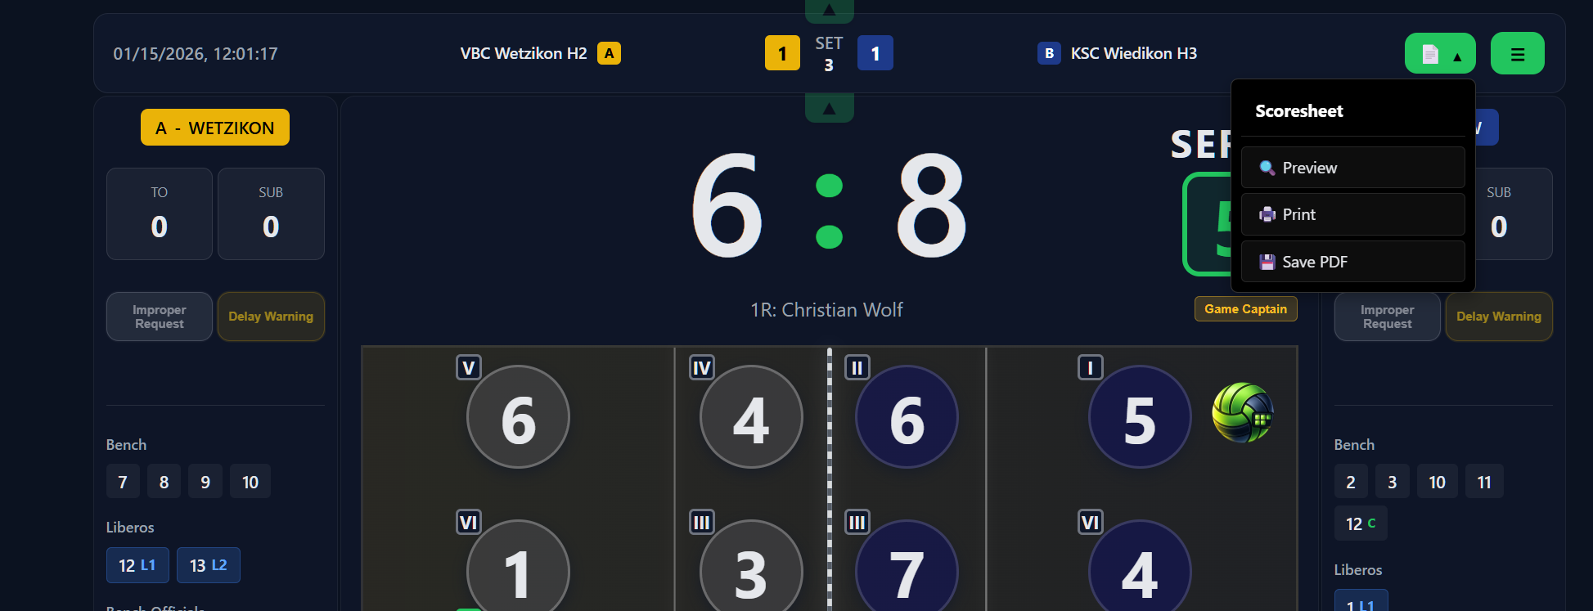
eScoresheet
Opens in a new page, can be looked at any time

Slide 23
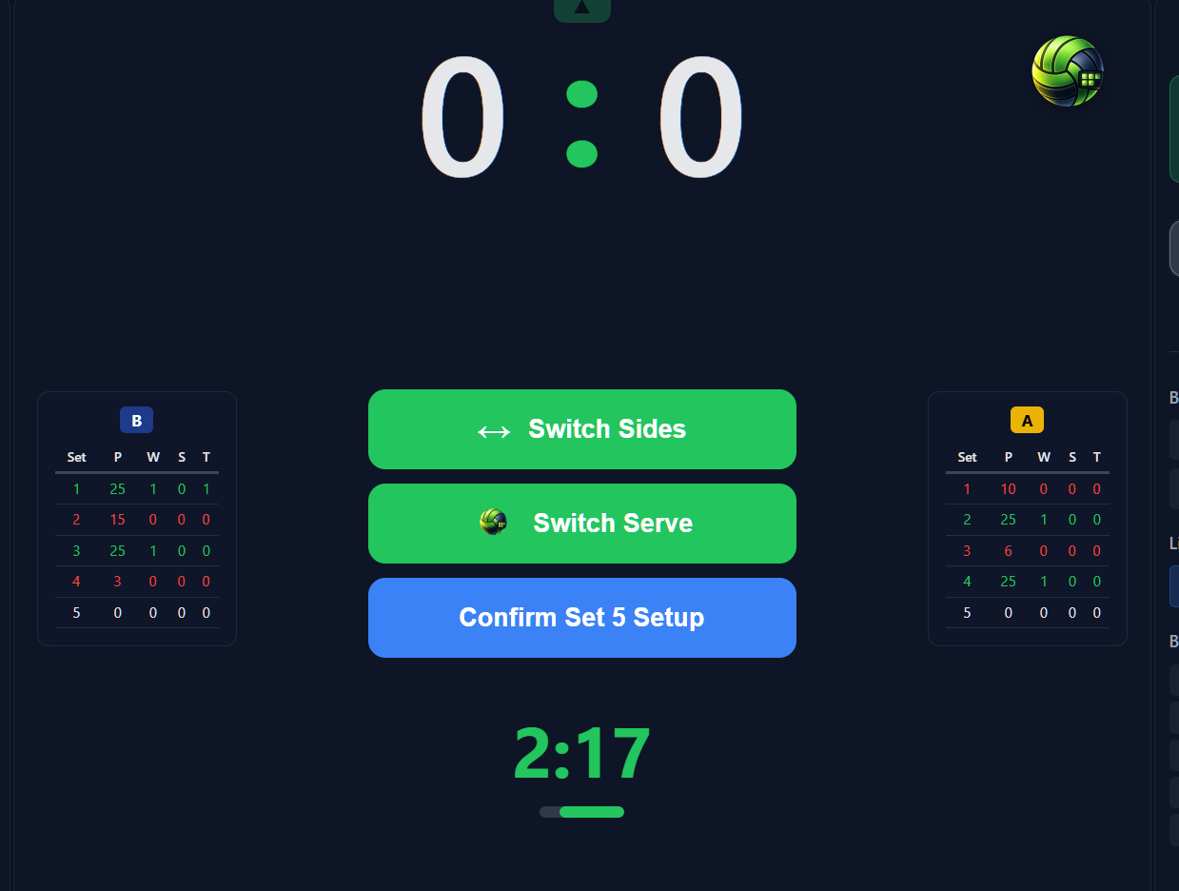
Set 5
Set 5 coin toss -> MUST BE CONFIMED

Slide 24
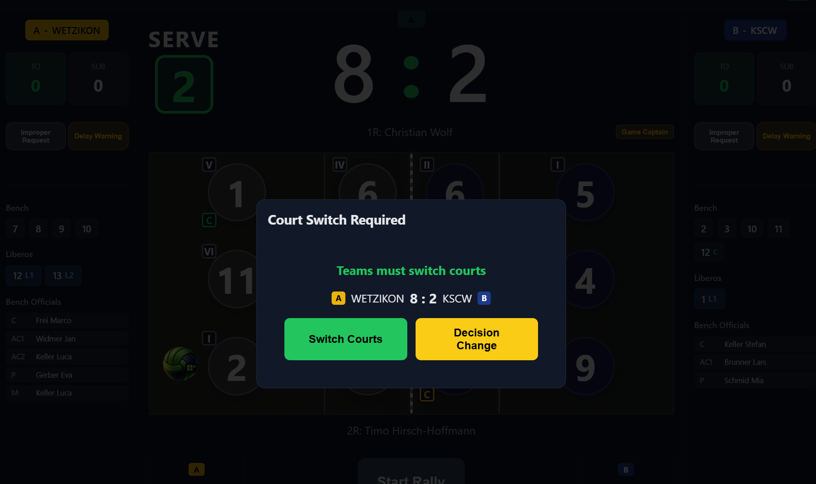
Set 5

Slide 25
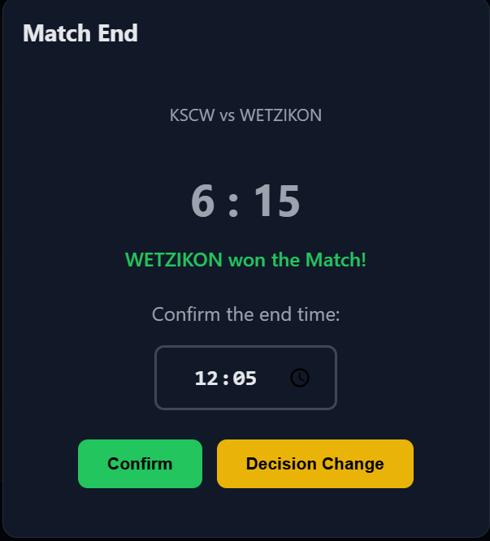
Match end

Slide 26
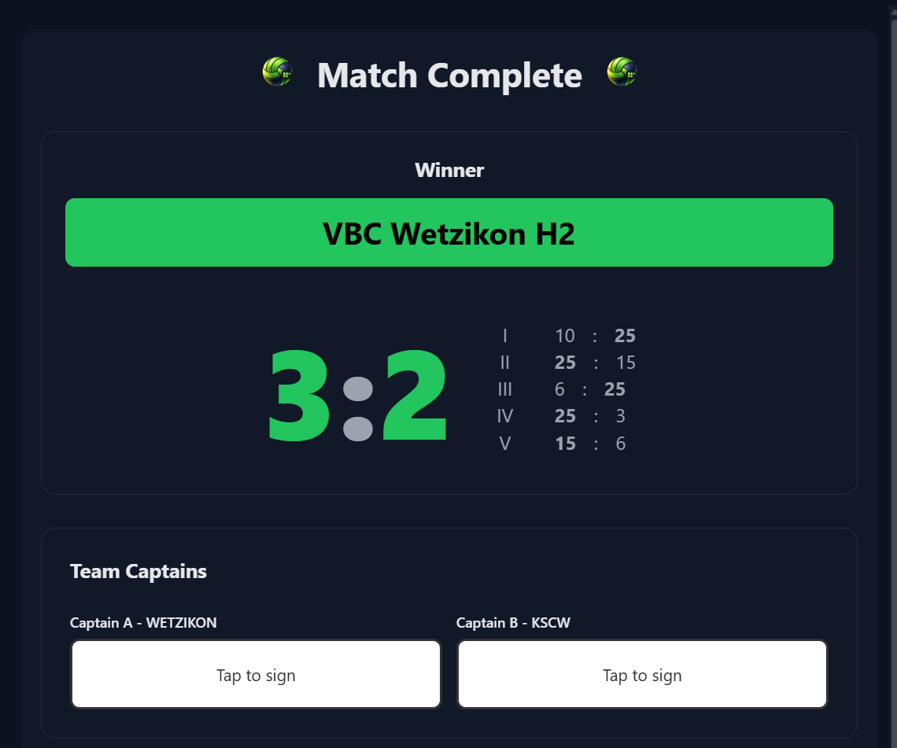
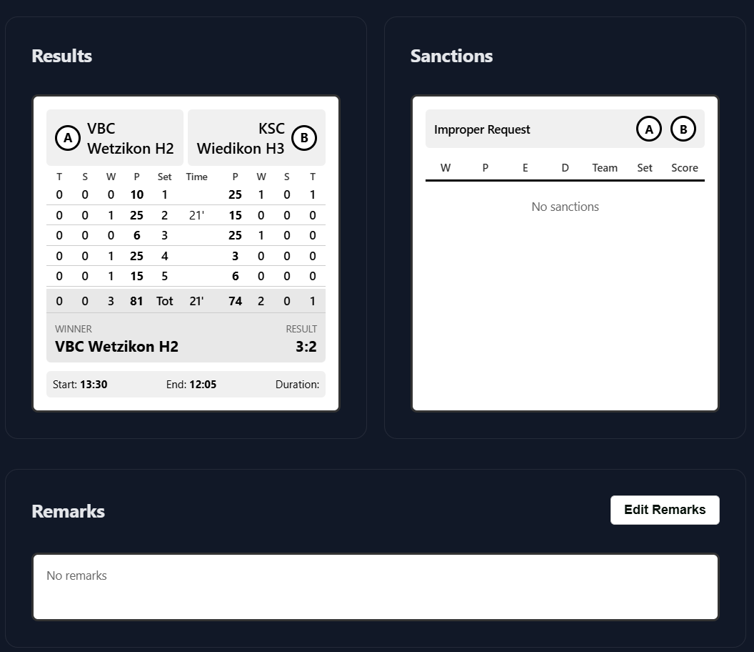
Match end
Captains sign first -> until then no other signature possible
Edit or add remarks if needed

Slide 27
Match end
Captains sign first -> until then no other signature possible
Edit or add remarks if needed

Slide 28
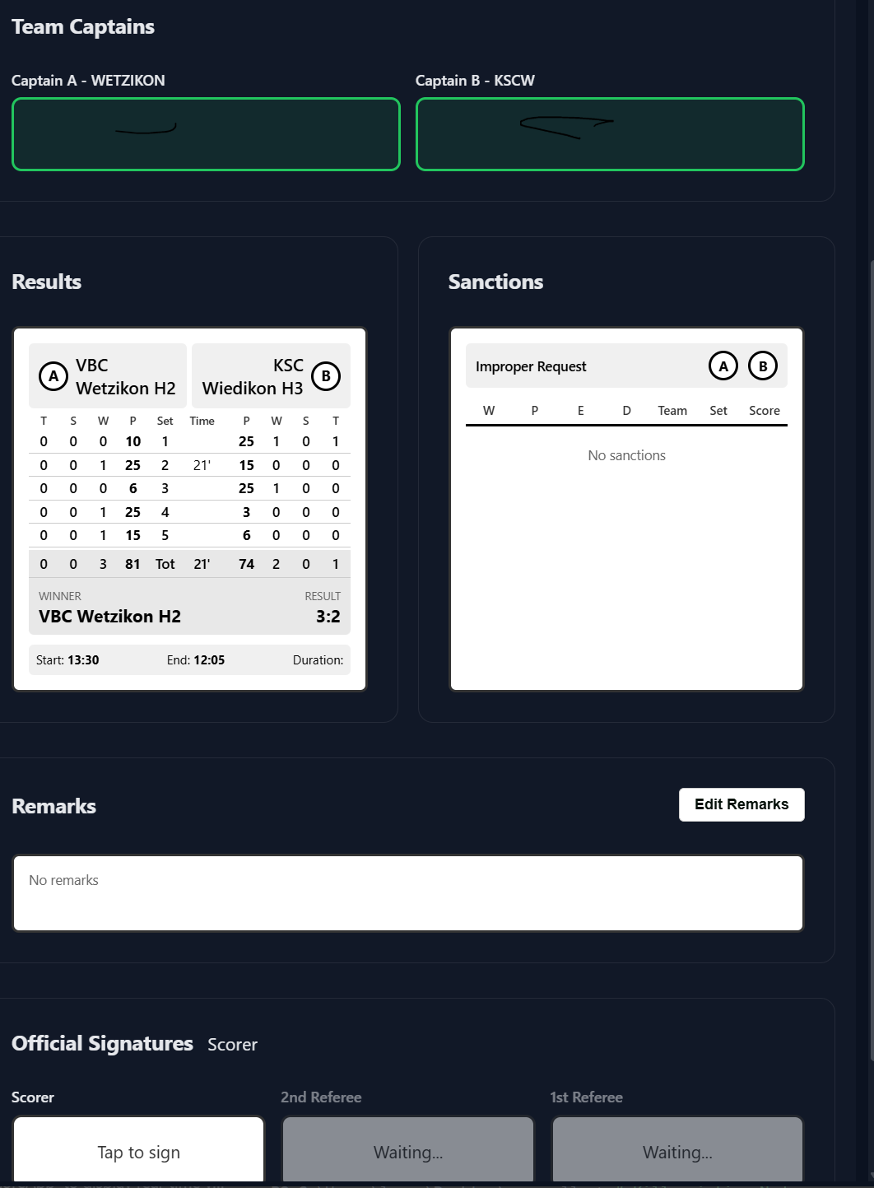
Match end
Ass scorer (if present) signs first, then scorer, then 2R (if present), then 1R

Slide 29
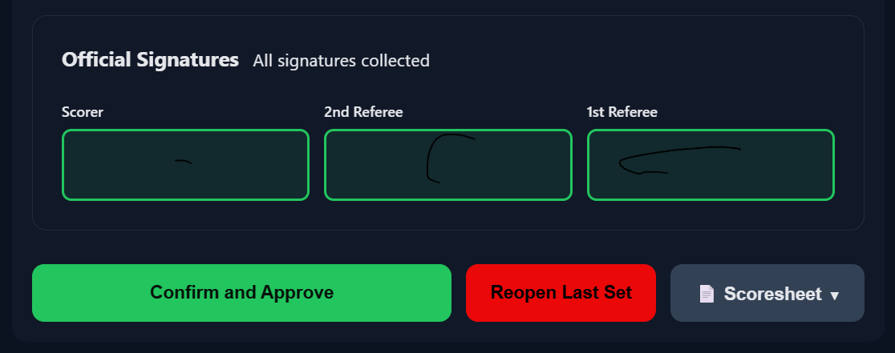
Match end
Approve the match, sets it final, uploads to cloud (if online) and downloads scoresheet and match data
Reopens the last set if needed (also in case of manual adjustments)

Slide 30
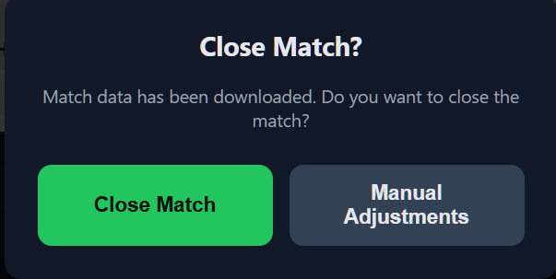
Match end
Closes the match definetely
Changes data IN CASE OF EXTREME CIRCUMSTANCES

